Slide 1
Theme 5 - Allotment of Symbols and list of Contesting Candidates
Guidance Plan:
This sub-theme will require RO to primarily navigate the Symbols Order r/w R 5 and 10 of COER 1961.
Notice regarding venue, date and time of allotment of symbol has already been given individually to each candidate at the time of filing nomination. RO has to start the process at the appointed time (which will obviously be after the withdrawal stage – i.e., after 3:00 P.M on the last date for withdrawal of candidature).
RO has to ensure that he has the latest/updated notification of ECI, notifying the list of political parties and election symbols. Also, ensure that all orders of ECI regarding concessions under paras 10, 10A, 10B of Symbols Order are also available for reference.
RO to take special care to avoid wrong allotment of symbol. In terms of previous data, the most likely vulnerability comes w.r.t allotment outside the notified list; reserved symbols being allotted to non-entitled candidates; repeat allotment of free symbol to more than one candidate etc.
This domain primarily led by ECI and the periodic orders that are passed which must be carefully monitored by the RO. RO’s domain on allotment of symbols is a residual domain focussing on last mile allotment of free symbols to independent candidates and candidates of RUPP, who are not covered under the common symbol allotted by ECI (para 10B).
Any wrong allotment can only be corrected by ECI under R 10 COER, 1961
Publication of list of contesting candidates – its format and language and follow-up actions are governed by S 38 RPA 1951, R 10 COER 1961, and ECI directions
RO must take note of R 10(5) COER 1961, whereby error regarding allotment of symbol can only be rectified by ECI.
RO must be clear that this list of contesting candidates (7A) and the particulars therein like name, address, etc. form the ‘single source of reference‘ for the entire poll process and will also populate the relevant IT platforms of ECI.

Slide 2
Timing and listing of background steps already covered:
The allotment of symbols is taken up after the stage of withdrawal of candidature and before the preparation of list of contesting candidates in Form 7A. It maybe recalled that the nomination paper requires the candidate to make a request regarding the symbol to be allotted to him/her. Form A & B, for party candidates is required to be filed with the nomination paper or upto 3:00 PM on last date of filing nomination
At the stage of filing nomination, RO is required to give notice to each candidate regarding date, time and venue of allotment of symbol (ECI Instruction)
The RO is required to prepare for this event which will be governed by the Symbols Order 1968 – which this presentation will explain in detail
RO may note that this is the penultimate step to the stage of publishing list of contesting candidates in Form 7A, which in turn becomes the basis of generation of Ballot Paper, Postal ballot paper, ETPBS, IT Platform and Apps pertaining to candidates etc.
Hence, need for zero-error.

Slide 3
Legal Framework - Apex Court Rulings
“The importance of the symbols to our system of elections needs no exaggeration. Symbols are its very soul & without them the exercise of franchise by the majority of our citizens would be impossible. No doubt elections are fought on party lines, but even if there is a plebiscite between parties, the symbols play a key role …. In fact the voters are asked to vote for this symbol or that symbol….”
Samyukta Socialist Party V/S ECI & Ors; (AIR 1967 SC 898 )
Some more observations in…..
  Sadiq Ali and Anr v/s ECI and ors. (AIR 1972 SC -187)
  Kanhiya Lal Omar v/s RK Trivedi & ors.(AIR 1986 SC - 111)

Slide 4
Legal framework – R 5 & R 10 of COER 1961, r/w Symbols Order, 1968
R 5 & R 10 of COER 1961, read with Symbols Order, 1968, is the Legal Framework for allotment of Symbols by the RO to candidates of National Recognized parties; State Recognized Parties; RUPP and Independent Candidates
Symbols are classified as Reserved Symbols and Free Symbols (para 8 of Symbols Order)
Free Symbols are also allotted as Common Symbols for Candidates of RUPP, in defined circumstances (para 10 B of Symbols Order)
NB 1: It is essential to refer to the updated list of National Recognized Parties, State Recognized Parties and RUPPs, as notified by the ECI under para 17 of the Symbols Order
NB 2: Common Symbol may be allotted to Candidates of RUPP by ECI on application made by such Parties under para 10B of symbols order
NB 3: Concession of allotment of Reserved Symbol of State parties to their Candidates in a different State may be made by ECI on application made under para 10 of Symbols Order
NB 4: Allotment of Symbols to other Candidates, from the rest of the available Free Symbols, are made by the RO in terms of procedure laid down in para 12 of Symbols Order

Slide 5
Applicability
Election symbols (Reservation & Allotment) Order,1968.
(1 to 18 paras)
Symbol Order is applicable only in Lok Sabha
& Assembly Elections.
Not applicable in election to the council & election
to the council of States & States Legislative councils.

Slide 6
Matters governed by Symbols Order
Prior to Aug 1968, there was no certified set of guidelines governing allotment of election symbols to candidates
ECI felt it appropriate to lay down comprehensive guidelines in this regard and accordingly issued the ELECTION SYMBOLS (RESERVATION AND ALLOTMENT) ORDER, 1968
Constitutional validity of the Symbols Order was upheld by the Apex Court in Kanhiya Lal Omar vs R.K. Trivedi & Ors (AIR 1986 SC 111)
Symbols Order deals with Recognition of Political Parties as National and State Parties, allotment of Reserved Symbols for Recognized Parties, allotment of election symbol to candidates of Registered Unrecognized Political Parties(RUPPs) and independent candidates (para 8, 10, 10A, 10B, 12). It also lays down the conditions to be fulfilled for treating a candidate as candidate of a political party (para 13 & 13A)

Slide 7
Classification of Symbols
(Para - 5)
Symbol
Reserved
Free
Symbol
Symbol
Recognized State Parties (in the State concerned)
Registered
Recognized National Parties
For Independent candidates
Unrecognized
Political
Parties

Slide 8
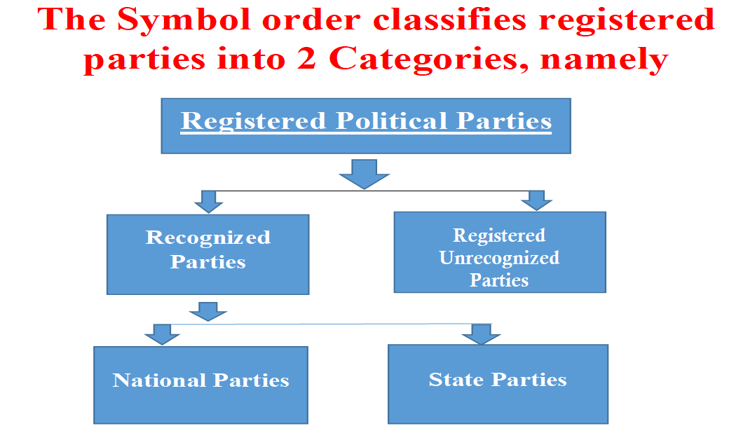
Classification of Political Parties
( Para 6,7)

Slide 9
Checklist for Symbol Allotment
Refer to the latest notification of Political Parties and Election Symbols issued by ECI
Obtain the updated copy from the CEO office as soon as election is announced.
Collect all orders of ECI regarding concession to recognized State parties of other States to use their Reserved Symbol (para 10), orders regarding concession under para 10A and concession to RUPP regarding common symbol for their candidates (para 10B)
Contd…

Slide 10
Checklist for Symbol Allotment – contd.
4. Allot Reserved symbol to the candidate of a recognized political party only and to no other candidate.
5. Consider the choice of a symbol made by a candidate (Other than recognized - state or national - political party) in his/her first nomination paper only, even if that nomination paper is rejected.

Slide 11
Para 8 (1) - Choice of symbols: National and State Parties
A candidate set up by a National Party - shall be allotted, the symbol reserved for that party and no other symbol.
A candidate set up by a State Party at an election in a State in which such party is a State Party - shall be allotted the symbol reserved for that Party in that State and no other symbol
NB: A Reserved Symbol shall NOT be allotted to any candidate other than a candidate duly setup by the Recognized party for which that symbol is reserved.

Slide 12
Para 10 – Concession: Candidates set up by State Parties in other States – to be decided by ECI
The candidates setup by a State Political Party of another State may be allotted the symbol reserved for that party in the State in which it is a recognised State Party, if and only if the ECI has ordered such allotment under para 10.
NB: Please note that all requirements of para 13 (regarding setting up of candidates) should be duly complied with by the Party and candidates.

Slide 13
Para 10A – Concession: Candidates set up by Unrecognised Party which was earlier a National / State Party - to be decided by ECI
On an application made by a party which is presently RUPP, but was a recognized party at anytime in the last 6 years, ECI may order allotment of the erstwhile Reserved Symbol of the party to its candidates (para 10A Symbols Order).
Candidate duly setup by such party can be allotted the symbol reserved earlier for that party when it was recognized National /State party only if the ECI has passed order to that effect

Slide 14
Allotment of common symbol for candidates of RUPP
Para 10B: Concession to candidates set up by registered (unrecognized) parties & to unrecognized parties which were earlier recognized more than 06 years back
Commission may allow any RUPP to use a common symbol (if it fulfills certain conditions) from the list of free symbols for prescribed constituencies, in terms of para 10B. Party has to submit application to ECI for this purpose.
Some important conditions : (in case of ACs)
1) That the party will set up it’s candidates at least in 5% ACs to a
minimum of 03 ACs in case of states having 60 ACs.
2) That the party will give an undertaking that in case if it fails to
adhere to above condition, it’s candidates shall not be entitled
for such common symbol & in addition to that the party shall
be liable for such punitive actions as ECI may consider appropriate.
3) The party will submit the list to ECI, containing
serial numbers & names of the constituencies where it intends
to set up it’s candidates within prescribed time limit.
NB 1: The symbol allotted as common symbol to a RUPP will be available to other candidates in other constituencies
NB 2: Even in constituencies when a common symbol is allocated by ECI to candidates of an RUPP, if that RUPP has no candidate, other candidates who may have opted for that symbol may be allotted that symbol

Slide 15
Common Symbol in Lok Sabha Election
Para 10B: Concession to candidates set up by registered (unrecognized) parties & to unrecognized parties which were earlier recognized more than 06 years back
Some important conditions : (in case of PCs)
1) That the party will set up it’s candidates at least in 02 PCs in
the state (where that state have 02 or > 02 PCs) in which it
seeks such concession.
2) That the party will give an undertaking that in case if it fails to
adhere to above condition, it’s candidates shall not be entitled
for such common symbol & in addition to that the party shall
be liable for such punitive actions as ECI may consider appropriate.
3) The party will submit the list to ECI, containing
serial numbers & names of the constituencies where it intends
to set up it’s candidates in prescribed time limit.

Slide 16
Sample Q&A
Which symbol will be allotted in the following cases?
to a candidate of a recognized national party?
to a candidate of a recognized state party?
A free symbol is chosen by only one candidate. (Other than recognized party)

Slide 17
Allotment : Different Scenario
If A free symbol is chosen by more than one candidate.

Slide 18
Different Scenario (Para-12 of Allotment order)
to Candidate of a recognized national party
to Candidate of a recognized state party
A free symbol is chosen by only one candidate. (Other than recognized party)
Only reserved Symbol of that national party
Only reserved Symbol of that state party
Allot him/her only. (and NOT to any other candidate)
(Contd…)

Slide 19
Different Scenario (Para-12 of Allotment order) - contd
A free symbol is chosen by more than one candidate
Allot to a candidate of a registered-unrecognized party (if the other candidates are all independents)
If more than one candidate of RUPP choose the same symbol, and if one of them was a “sitting member” of the concerned house immediately before such election, allot the symbol to that candidate (Plz see clause (b) of sub-para (3) of para 12)
(Contd…)

Slide 20
Different Scenario (Para-12 of Allotment order) - contd
A free symbol is chosen by more than one candidate
if no such candidate of RUPP was a sitting member of the concerned house, allot the symbol by lot amongst those candidates
If all the candidates choosing the symbol are independents, and if one of them was a sitting member of the concerned house immediately before such elections, and was allotted that free symbol in the last election, then the free symbol shall be allotted to that particular candidate.
(Contd…)

Slide 21
Different Scenario (Para-12 of Allotment order) - contd
4. A free symbol is chosen by more than one candidate
If all such candidates are independents & no one was a sitting member immediately before such elections, allot the symbol by draw of lots amongst them
(Contd…)

Slide 22
Allotment : Different Scenario – contd.
If you receive 2 different notices in Form B for 2 candidates of the same recognized party which does not state that the earlier notice/s have been rescinded…
(Contd…)

Slide 23
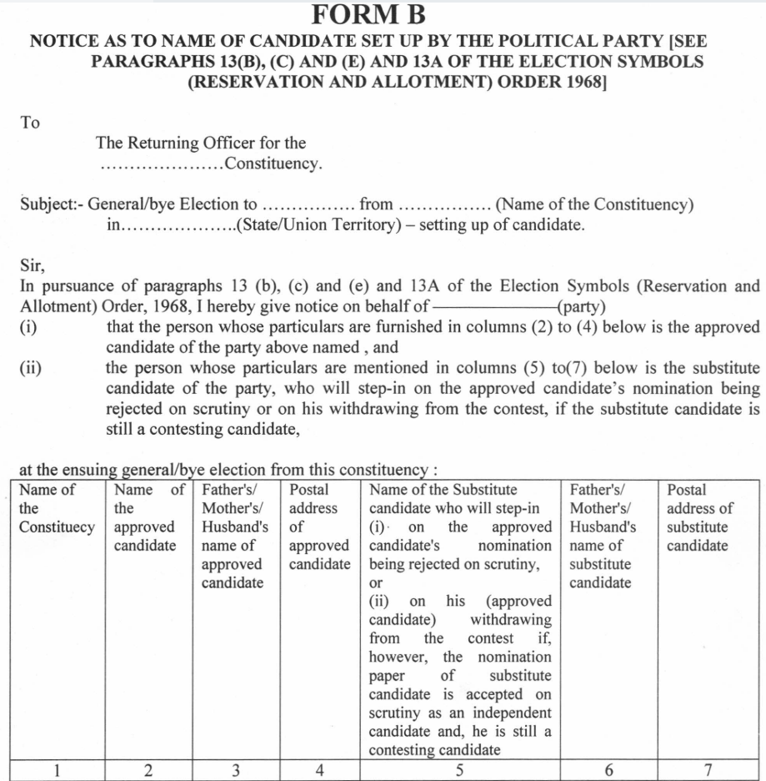

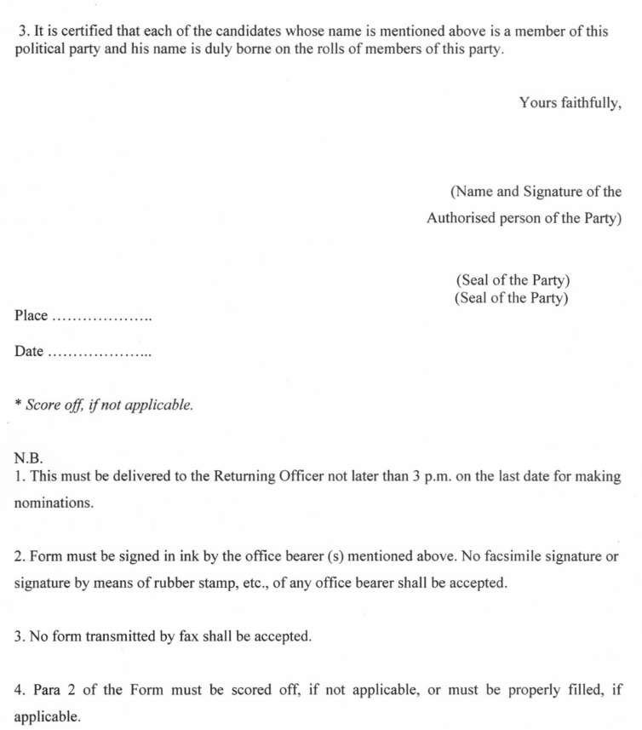
(Contd…)

Slide 24
Allotment : Different Scenario – contd.
5. If you receive 2 different notices in Form B for 2 candidates of the same recognized party which does not state that the earlier notice/s have been rescinded…
Allot the reserved symbol of that party to a candidate whose NOMINATION PAPER (and NOT FORM-B) was first submitted to you.
(Contd…)

Slide 25
Allotment : Different Scenario - contd
If a candidate had not made a declaration in any of his/her nomination paper that he has been set up by a particular recognized political party… &
If that party gives you intimation in Form A and Form B…
(Contd…)

Slide 26
Allotment : Different Scenario - contd
If a candidate had not made a declaration in any of his/her nomination paper that he has been set up by a particular recognized political party… &
If that party gives you intimation in Form A and Form B…
You should NOT allot the reserved symbol of that political party to that candidate.
(Contd…)

Slide 27
007 – Roopnagar A.C. !! CASE STUDY !!
– contd.
Status 0f candidates in 2019 elections |  |  | Elections 2024 (Status) | Symbols demanded in 2024 elections | RO’s decision
Candidate - A (Recognised Party) | (Reserved Symbol) | Sitting member | Independent | Air conditioner, Umbrella, Pen | Draw*
Candidate-B (RUPP) | (Candle) | Sitting member | Independent | Air conditioner, Umbrella, Pen | Draw *
Independent-C | Match Box | Sitting member | RUPP | Air conditioner, Umbrella, Pen | Air conditioner
Independent-D | Candle | Sitting member | Independent | Air conditioner, Umbrella, Pen | Draw *
Independent-E | Umbrella | Not a Sitting member | Independent | Umbrella, Pen, Air conditioner, | Umbrella
(Contd…)

Slide 28
CASE STUDY - – contd.
*Draw of lot between candidates A, B & D. In result of the draw, only one candidate will be allotted the symbol PEN .
Then remaining two candidates will be allotted symbols by RO from the list of available free symbols.
(Contd…)

Slide 29
Allotment : Different Scenario – contd.
Paragraph 10: Concession to candidates set up by a State party at elections in other states or UTs
Such candidate can be allotted the symbol reserved for that party in the state /states in which it is recognized state party, if and only if there is an order of ECI for such allotment under para 10
Paragraph 10A: Concession to candidates set up by an unrecognized party which was earlier recognized as a National or State party during the last 6 years
Such candidate can be allotted the symbol reserved earlier for that party when it was recognized party, if and only if there is an order of ECI for such allotment under para 10A
(Contd…)
(in both the cases above, commission’s specific direction under respective para is must)

Slide 30
Allotment : Different Scenario – contd.
In such cases :
That symbol will be allotted to candidates of RUPP concerned in those constituencies
That symbol will be free symbol in other constituencies
That symbol will be considered a free symbol even if it is allotted to a particular party, in case……….
A) If such party fails to setup its candidate in that/those constituencies
B) If nomination of its candidate is rejected or the candidate withdraws
c) If such party fails to adhere to the conditions laid down in above paras.
(Pls refer sub-paras (1 & 5) of clauses (A) & (B) of para 10B)
Paragraph 10B: Concession to candidates set up by registered (unrecognized) parties & to unrecognized parties which were earlier recognized more than 06 years back
(Contd…)

Slide 31
Different Scenario (Para-10B of Allotment order) - contd
Looking to the provisions discussed in previous slides for the
concession in Para 10B, RO may take care of certain important
points like ….
To intimate the CEO’s office on last date of nomination whether the party has setup it’s candidate or not, as per the list provided by ECI. (That will help to ascertain the minimum number of candidates of that party)
If it is ascertained that such party fails to attain the minimum criteria, the Commission may direct not to allot the common symbol to the candidates of that party at the time of allotment of symbols & punitive actions may also be initiated by the Commission against such party.
Provision (b) above doesn’t prevent the RO to allot that symbol, if other conditions are fulfilled, to the sitting member of the same house even if he is setup by the party discussed above.
(Contd…)

Slide 32
!! INCORRECT ALLOTMENT !! – contd.
The allotment made by RO is final
EXCEPT…..
It is inconsistent with provisions of Symbols order or any direction issued by ECI in that behalf.
(R. 10 (5), COER 1961)
(Contd…)

Slide 33
!! INCORRECT ALLOTMENT !! – contd.
In such case….
  The list of contesting candidates should be revised accordingly.
  If the earlier list has already been published, such revised list should again be published.
  Copies of such revised list should be furnished to each contesting candidate.
Commission’s authority to revise incorrect allotment
(R 10 (5) COER 1961)

Slide 34
Allotment of symbols - SUMMARY
Allotment of Symbols starts, once the Withdrawal Process is completed
The nomination paper requires the candidate to make a claim for a symbol
Ascertain that the list of Symbols is latest
Mainly 02 types of Symbols – Free Symbols & Reserved Symbols
Mainly 02 categories of parties – 1.Recognised 2. Registered Unrecognised
Study carefully Form A & B – mock practice to fill it up will help you a lot
Advisable to refer to paras (especially) 08 to 13A as often as you can
Give a copy of allotted Symbol to the candidate
Allotment of Symbols by RO is final (except inconsistent with the provisions)
Faulty allotment attracts revision by ECI (Not expected from a good RO)

Slide 35
List of contesting candidates – S 38 RPA 1951, R 10, Form 7A, COER 1961
Preparation of 7A – language – modifications in name of candidates:
RO to prepare list of contesting candidates in Form 7A immediately after completing allotment of symbols.
Language(s) in which list in Form 7A is to be prepared have been specified by the Directions issued by ECI under R 10(1) COER, 1961. Please refer to the Direction no.3/4/2008/JS-II/SDR, dated 16/09/2008 (for LA elections) and Direction no.3/4/2008/JS-II/SDR, dated 06/02/2009 (for LS elections). These are reproduced in RO Handbook.
Proviso to R 8(2) COER 1961, allows a candidate to request for modification in his/her name, if the name is incorrectly spelt/shown in the nomination paper or is different from the name by which the candidate is popularly known. Such request can only be made before preparation of list in Form 7A
If RO is satisfied that the requested is genuine, RO shall allow the modification before preparing list in Form 7A
Contd…

Slide 36
List of contesting candidates – arrangement of names - S 38 RPA 1951, R 10, Form 7A, COER 1961 – contd.
Order of arrangement of names & particulars to be entered:
Names of candidates to be classified in 3 categories – (i) candidates of Recognized National/State parties, (ii) candidates of RUPP (which will include State parties of other States) and (iii) the independent candidates
Within each group, names of candidates to be arranged in alphabetical order
If Form 7A is to be prepared in more than one language (as specified in ECI Direction), the script of the language first specified in the Direction is to be followed for deciding the alphabetical order of arrangement
RO to ensure that all particulars such as name of candidate, address, party affiliation(in case of party candidate), symbol allotted are all correctly reflected in Form 7A. Incorrect particulars will have serious consequences.
Photograph of candidate is also to be printed against the name of the candidate.
NOTA is not to be mentioned in Form 7A
Contd…

Slide 37
List of contesting candidates – publishing- S 38 RPA 1951, R 10, Form 7A, COER 1961 – contd.
Publishing the list of contesting candidates in Form 7A:
List in Form 7A is the first document prepared by RO to be published in the gazette
Immediately after Form 7A is drawn, RO shall give a copy to each of the contesting candidates and affix a copy on his notice board
In the case of LA election, Form 7A is required to be published in the official gazette of the State/UT
In the case of LS election, Form 7A is required to be published in the GOI gazette and republished din the State/UT gazette.
RO shall send copies of Form 7A to ECI and CEO as soon as possible.
CEO shall arrange publishing in State/UT gazette
For LS election, ECI will arrange publishing in the central gazette

