Slide 1
Theme – 8A: Ballot paper
Guidance Plan:
This PPT brings out the legal provisions and ECI directions/guidelines on printing of Ballot Papers. The two types of Ballot Papers are for display on BU and the Postal Ballot Papers for those entitled to vote by post. It will be seen that the Ballot Paper meant for BU is also used as Tendered Ballot Paper. Each PS will be supplied with about 20 Ballot Papers for Tendered Ballot category.
As regards Postal Ballot Papers, it maybe seen that for Service Voters category, the ballot is generated through ETPBS. ROs should note the ECI directions regarding the particulars to be included on the Postal Ballot Paper. It is also important to note that there is a slight variation regarding the particulars to be included in the PB for Service Voter category vis-à-vis the other categories of voters voting through PB.
ECI directions also specify the language(s) in which Ballot Paper and Postal Ballot Paper is to be printed in all cases. There could be difference in the language(s) for constituencies in the same State. Therefore, ROs should necessarily study the ECI directions regarding form and language of Ballot Papers (refer to slide no.10).
NOTA and candidates’ photographs are to be printed on all Ballot Papers.
The timelines for printing of the Ballot Papers and assessing the no. of Ballots required have also been highlighted in the PPT (slide 3, 16)

Slide 2
Ballot Papers – 12 Topics covered –
Types
Quantities
Language
Colour (White/Pink)
Printing
Dummy
Symbols, including NOTA
Safe Custody
Content
Related Documents
Dispatch
Electors entitlements
Types-
EVM Ballot
Tendered Ballot
Postal Ballot
ETPBS
Dummy Braille Ballot Sheet

Slide 3
Assessment of requirement of ballot papers
Categories of ballot paper :
1.Postal ballot paper- Other than service voters (R 22 COER, 1961)
2.EVM ballot paper (R 49B COER, 1961)
3.Tendered Ballot paper (R49P, COER, 1961)
4.Braille paper (ECI Instructions)
Requirement of ballot papers
No. of EVMs to be used including the reserve EVMs
20 ballot papers per Polling Station for tendered ballot papers.
(c) In addition to point (i) & (ii) 10% of the above number may be printed extra for mutilation etc. at the time of fixing the BPs in the B.U., defective BPs.
(d) For postal ballot - electors in preventive detention, voters on election duty, security personnel in election duty, drivers-khalasis in election duty etc.
(e) Postal Ballot paper for AVPD, AVSC, AVCO and AVES

Slide 4
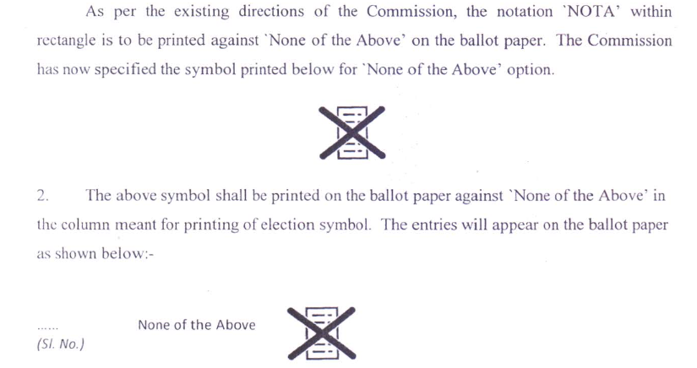
Symbol for NOTA

Slide 5
EVM Ballot Paper (R 49B COER, 1961), r/w ECI Instructions
Names of candidates in same language(s) in which the list in Form 7A ( including photograph) has been prepared.
In Lok Sabha Elections EVM Ballots papers shall be printed on White paper. In Assembly Elections EVM Ballots papers shall be printed on Pink paper.
Name of Constituency in English.
Names of candidates to be arranged in same order as they appear in list of contesting candidates, under 3 categories (S38 RPA, 1951) and, None of the Above – NOTA - (Form 7A)
NB 1: The headings of categories not to be printed in ballots.
Form and design of ballots as per directions given Chapter XI of the Hand Book for Returning Officers.
NB 2: Note the colour difference of Ballot Papers for simultaneous elections
NB 3 : Refer to ECI Instructions, in case of candidates being more than 15 in number, excluding NOTA
Contd…

Slide 6
EVM Ballot Paper (Photograph) – contd.
ECI No. 576/3/2015/SDR dated: 16.03.2015 & 576/3/2015/SDR dated. 21.5.2015
For facilitating the electors choice, ECI has directed that photographs of candidates are to be printed on ballot papers.
The photograph should be of stamp size of 2cm in breadth x 2.5 cm in height.

Slide 7
Tendered ballot papers (R 49P COER, 1961)
20 ballot papers to be sent to each polling station as Tendered Ballot Paper under sealed pack.
Tendered ballot papers shall be in same design and form as the ballot papers to be used in balloting unit of EVM.
The words "Tendered ballot paper" shall be stamped on the back of each such ballot paper.

Slide 8
Printing of Ballot Papers (ECI Instructions and RO Handbook)
The list of contesting candidates (Form 7A) to be sent on same day of its finalisation to CEO and the Govt. Press.
Transport and security arrangements to be ensured.
ARO in-charge of printing will leave at once for printing with the relevant documents.
Each bundle will have 20 ballot papers - Not to be stitched - Ballot papers will have consecutive serial numbers.
Exact alignment with BUs to be ensured.

Slide 9
Verification of ballot papers (ECI Instructions and RO Handbook)
Ensure that names, photographs and symbols have been printed properly and correctly and in correct order.
Ensure that there is no discrepancy in the numbers of ballot papers dispatched by the press and received by RO.
Defective ballots or with duplicate number, or missing number should be entered in register. They should not be issued to the PrO
Ballot papers should be kept in safe custody.

Slide 10
Postal Ballot Papers
ECI's direction regarding design, form and language of postal ballot paper are given in ECI No. 576/3/2015/SDR dated: 21.5.2015, No. 52/2015/SDR dated: 18.9.2015 & 52/2016/SDR-Vol.I dated: 24.02.2016
In Lok Sabha Elections Postal Ballots shall be printed on White paper. In Assembly Elections Postal Ballots shall be printed on Pink paper.
Postal Ballots when printed in one column shall be of width 4" to 6".
NB 1: Note the colour difference of Ballot Papers for simultaneous elections
Contd…

Slide 11
Postal Ballot Papers – Contd.
Postal ballots should be printed at State/District level at private or govt. printing press.
Printing with due care and with fool proof security arrangements
Depute an ARO, for strict watch.
Planning and identification of such private presses should be made well in advance.
Ensure that proper slugs, numbering machines, etc. are available at the press.
Contd…

Slide 12
Postal Ballot Papers – Contd.
Single column - up to 9 candidates (including NOTA) – In case of indivisible numbers of candidates, e.g. 11 candidates including NOTA, first six candidates will be shown in first column and remaining 5 will be shown in second column, and space at the end of second column for 12th candidate will be completely shaded.
Names of candidates shall be arranged in the same order under 3 categories in which they appear in the list (Form 7A) & the name in the last panel will be NOTA . Headings of categories should not appear in the ballot paper
Photographs of candidates are also to be printed on postal ballot papers.
Contd…

Slide 13
Postal Ballot Papers - contd.
Service Electors (ETPBS)
For Ballot Papers for Service Electors (ETPBS) - to be prepared in the official language of the State and in English (where English is not the official language)
There will be no symbol
Party affiliation, if any, of Candidates to be printed in the column for the name of Candidates
SL no | Name of candidate & party affiliation | Photo of candidate | Space for marking
NB: Difference between Postal Ballot Paper for Service Voters (ETPBS) and Other Categories of Voters must be understood and accounted for

Slide 14
Postal Ballot Papers – Contd.
For Postal Ballot Papers (other than Service Voters/ETPBS):
To be printed in the official language of the State and also in English (where English is not the official language)
Symbol to be printed.
Party affiliation not to be printed
Sl No. | Name of candidate | Photo of candidate | Symbol | Col. For marking vote
NB: Difference between Postal Ballot Paper for Service Voters (ETPBS) and Other Categories of Voters must be understood and accounted for
Contd…

Slide 15
Language of Postal Ballot Paper
Ref: R.22 COER, 1961 and Chapter XI of RO Hand Book–
Counterfoil in English only.
Service postal ballot paper and for other postal ballot papers - Particulars of Candidates and party affiliation in official language of the State and English both.
Particulars in official language of the State will appear first over those in English.
Particulars of Constituency and election in ballot paper will appear in English only.

Slide 16
Printing of Postal Ballot papers -
Returning Officers shall ensure that uploading of postal ballot papers and the connected papers for service voters on the ETPBS shall be completed by the day following the last date for withdrawal of candidatures.
Printing of postal ballots for other categories should be printed within 72 hours of withdrawals.
To be stitched in bundles of 50 ballot papers.
Ensure that Serial number on postal ballot and on its counterfoil are identical.

Slide 17
Dummy Ballot Sheets in Braille
(ECI instruction No. 51/8/INST/2018-EMS dated 28th June, 2018)
Dummy Ballot Sheets in braille to be printed and given to each polling station for use of visually impaired persons.
These Dummy Ballot Sheets in braille will be prepared in regional language (i.e. language printed on actual Ballot Paper) in addition to English.
The Dummy Ballot Sheets in braille prepared for every polling station will be certified by the Commissioner of Disabilities of concerned State through his authorized representatives.

Slide 18
Safe custody of undistributed ballot papers
After the issue of ballots, surplus undistributed ballot papers should be kept in safe custody
Such surplus ballot papers may also be used for fresh/adjourned poll.
After completion of the election, surplus ballot papers should be disposed off in the manner prescribed in Chapter 19 of RO Handbook, 2023

Slide 19
Ballot papers for record of ECI and CEO
Two un-issued ballot papers each in the case of General Election to the House of the People and the state Legislative Assembly should be sent to the Commission for its record. The Chief Electoral Officer should direct the Returning Officers in his State/ Union Territory to send two such un-issued ballot papers in respect ofeachconstituency to him with the words “Cancelled for record in the Election Commission” written on the reverse of each ballot paper under the signature of the Returning Officer as soon as possible, after election is over. The Chief Electoral Officer should then send the same to the Commission without delay. 19.21.2. The ballot papers in respect of bye-elections should also be sent to the Commission. The words “Cancelled for record in the Election Commission” should be written on the reverse of each ballot paper.

Slide 20
Ballot papers for record of ECI and CEO
Two undistributed ballot papers to be sent to ECI, through CEO, duly cancelled with words "Cancelled for the record in Election Commission“, written on the back of the Ballot paper, under the signature of the RO
The ballot papers in respect of bye-elections should also be sent to the Commission. The words “Cancelled for record in the Election Commission” should be written on the reverse of each ballot paper.

